Slide 1
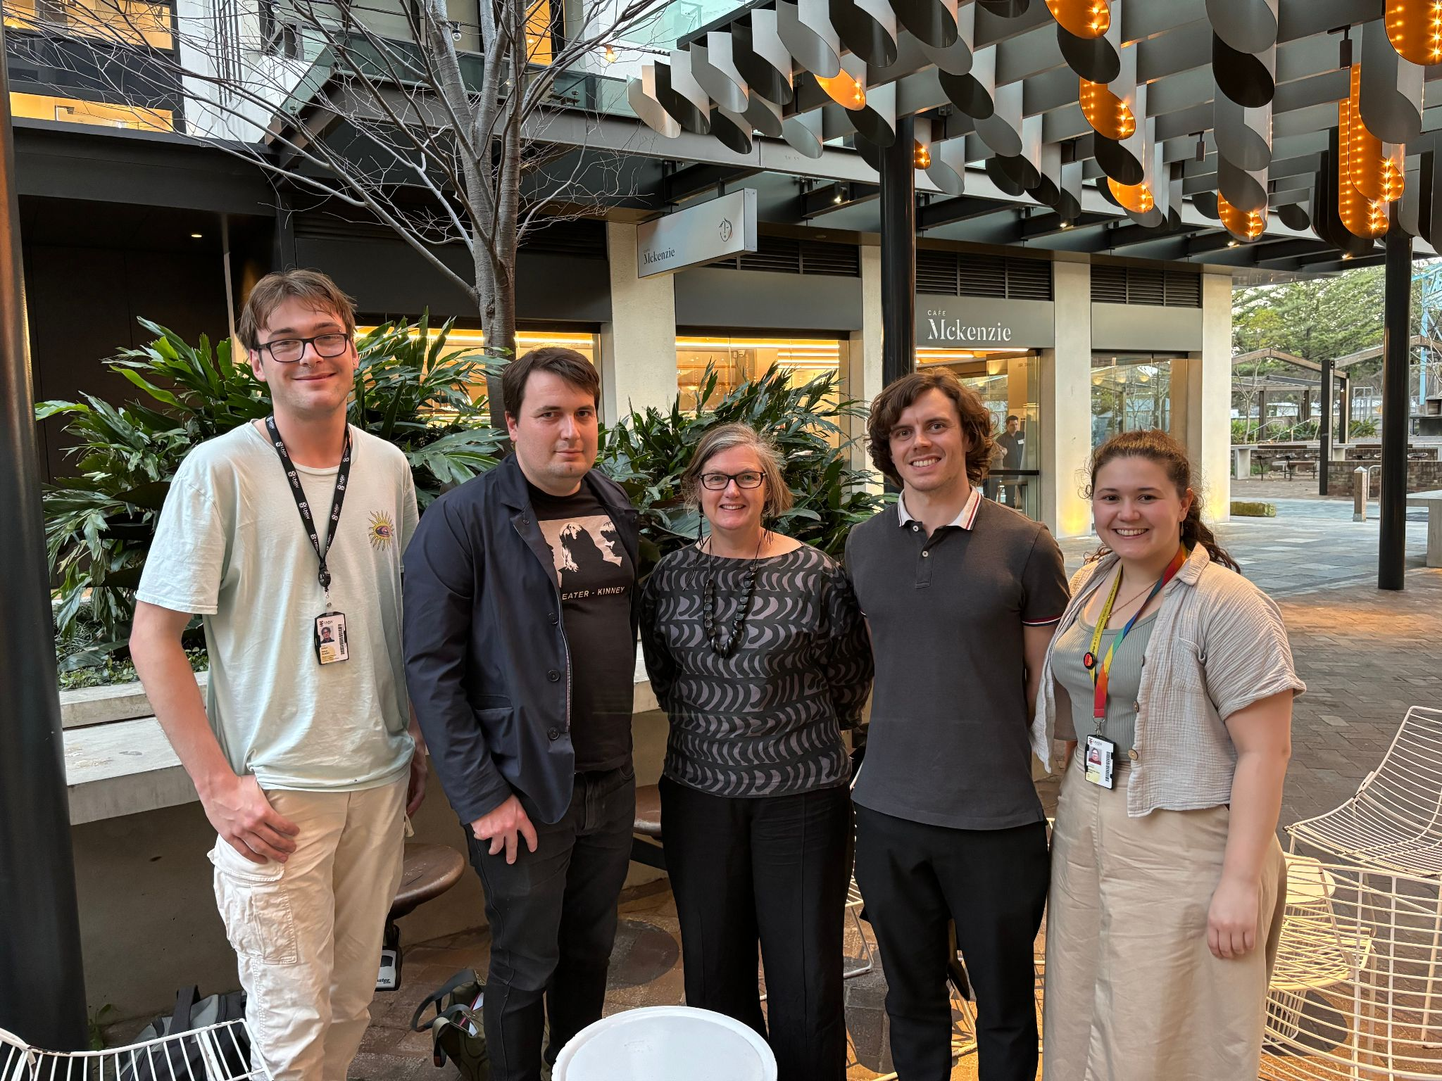
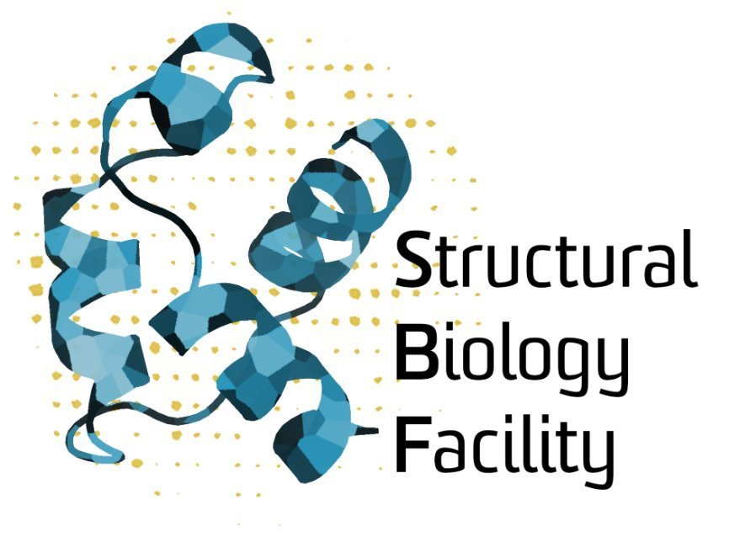
Serving next generation Structural Biology with GPUs
SBF Team (L→R): Nathan Glades, Keiran Rowell, Kate Michie, Josh Caley

Slide 2
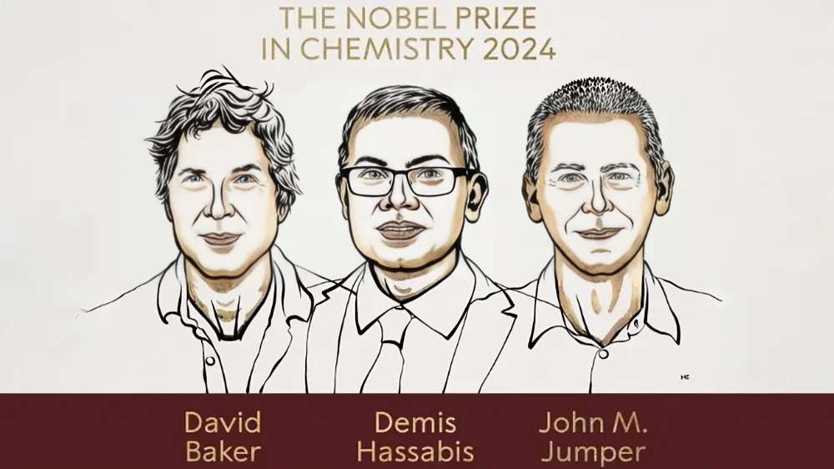
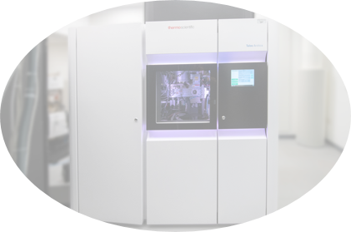
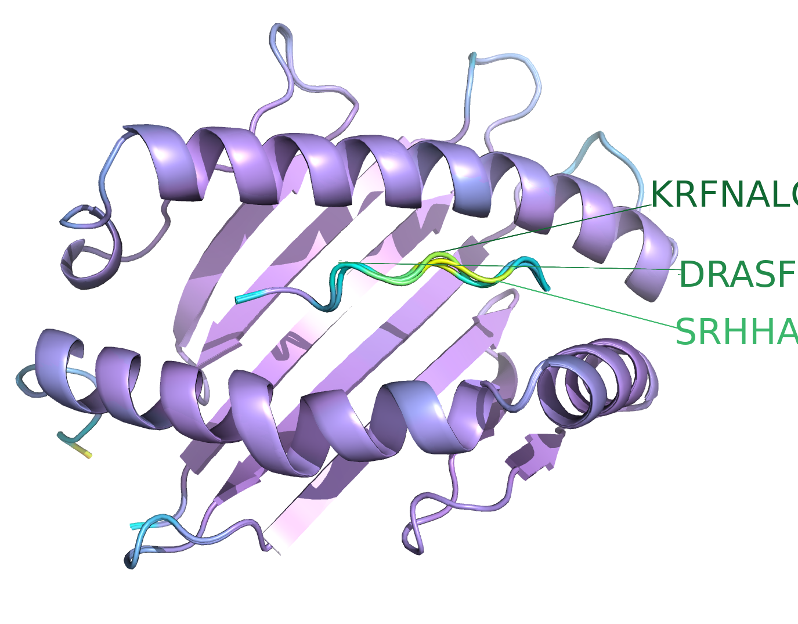
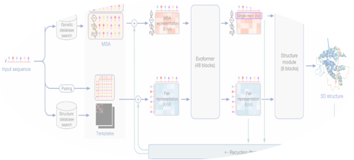
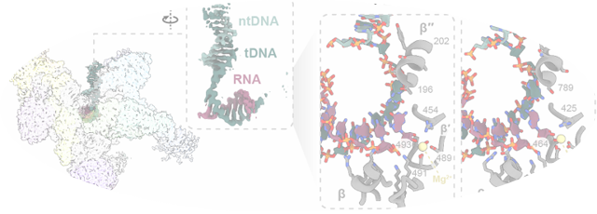
The revolution in Computational Structural Biology
From Instrument
From Computer
To Clinic
To Science

Slide 3
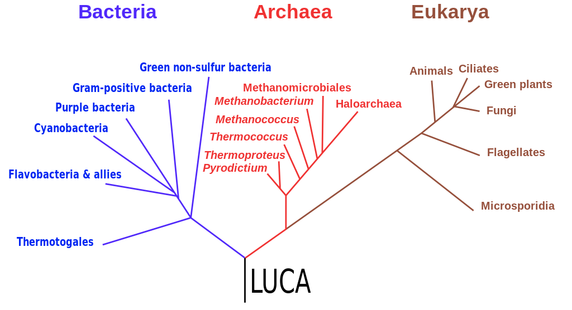


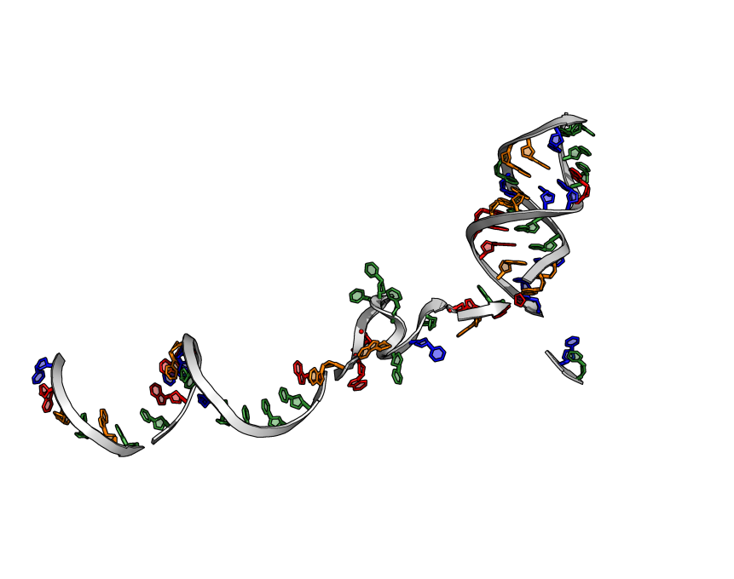
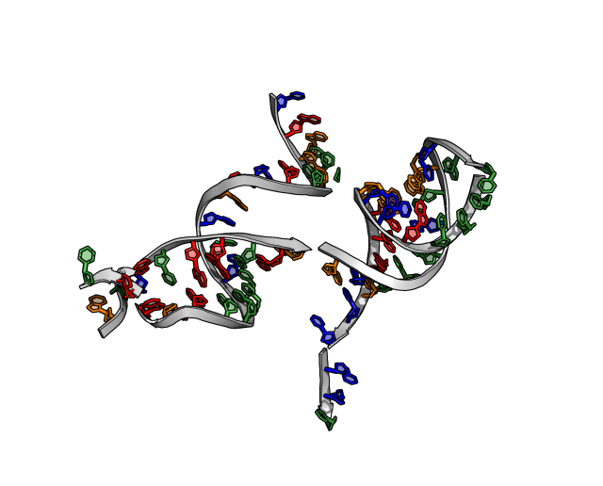
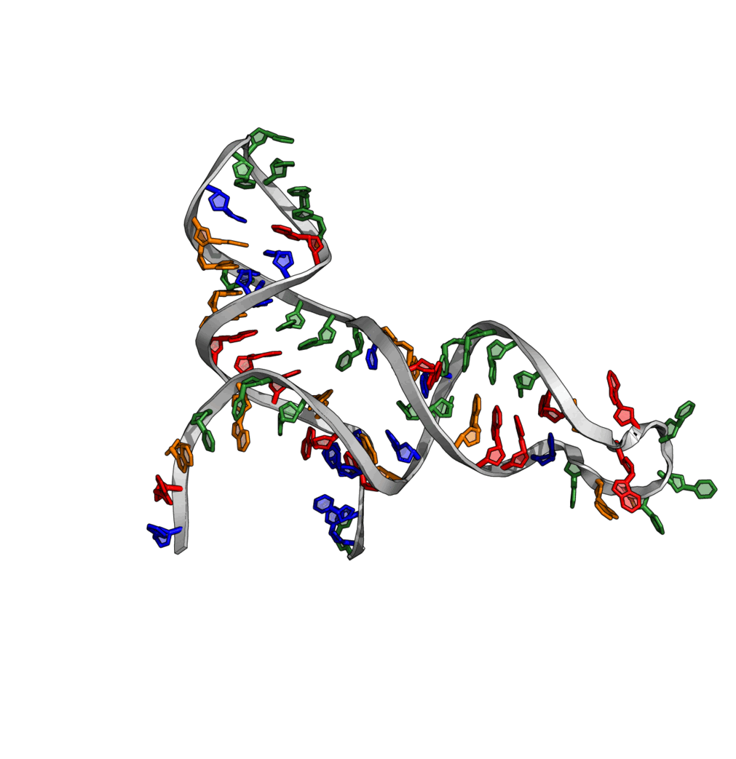

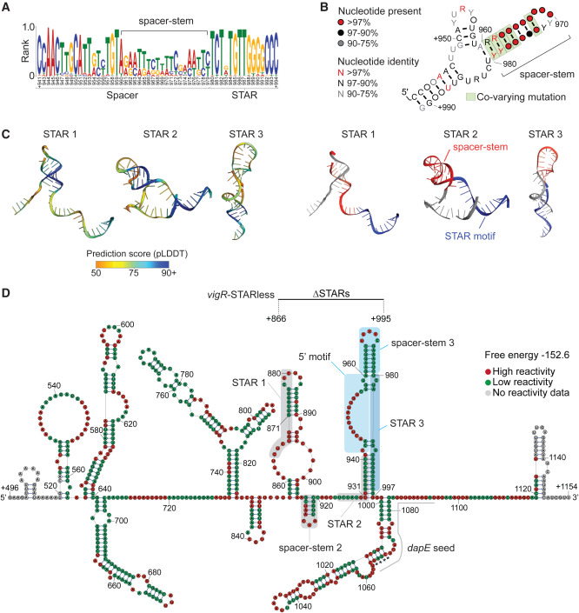
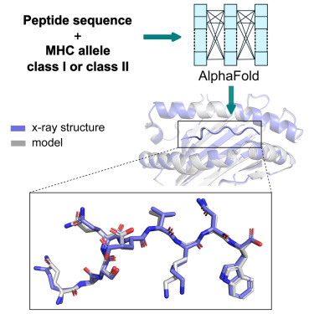
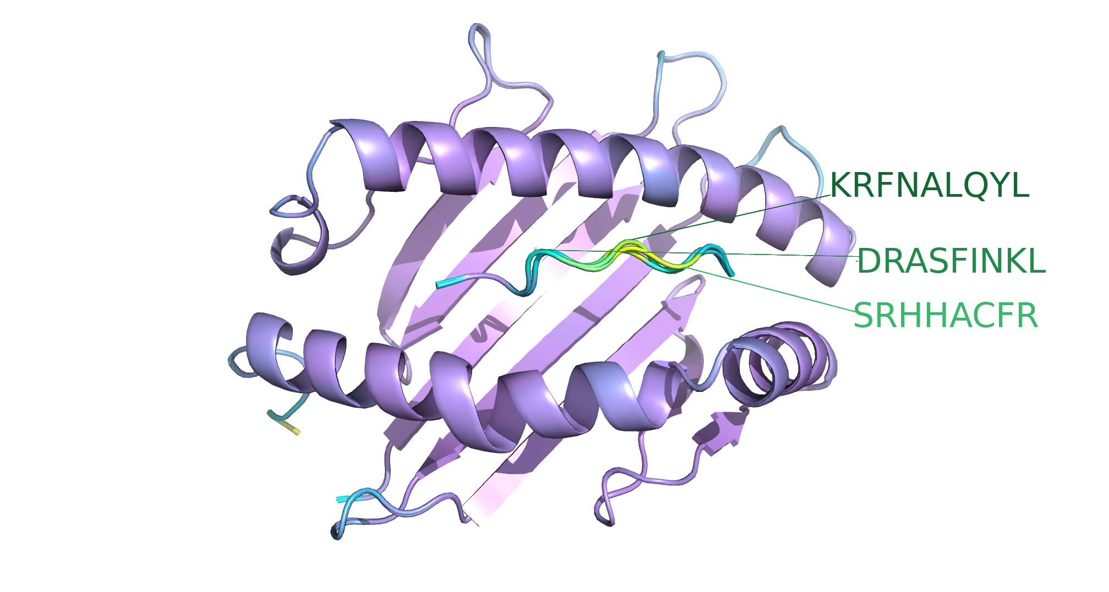
Deep Learning Biomolecular structures – Uses
Archaeal evolution – Michie/Burns Labs - ESMFold + FoldSeek
Sequence whole genome
Structural
4622 proteins
AFDB-search
Medical genomics – Oates Lab – RFoldNA
Molecular Dynamics
172 variants
Neurological disease (genetic)
'Healthy population'
'Sick kid'
Antibiotic Resistance – Tree Lab – RFoldNA
Immune response – Tedla Lab – T(Cell)Fold
'Golden Staph'
vancomycin
tolerance via
RNA structures

Slide 4
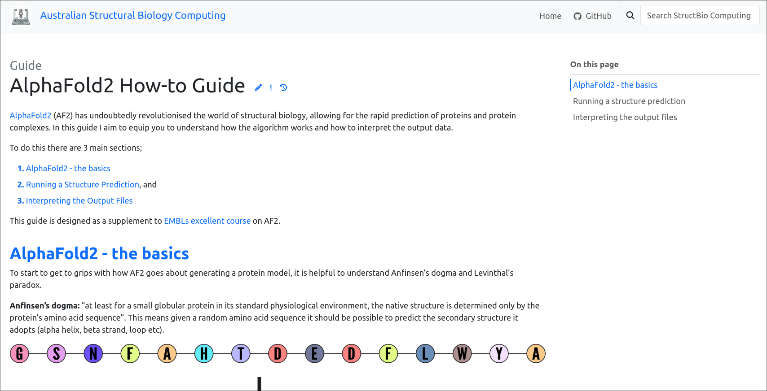
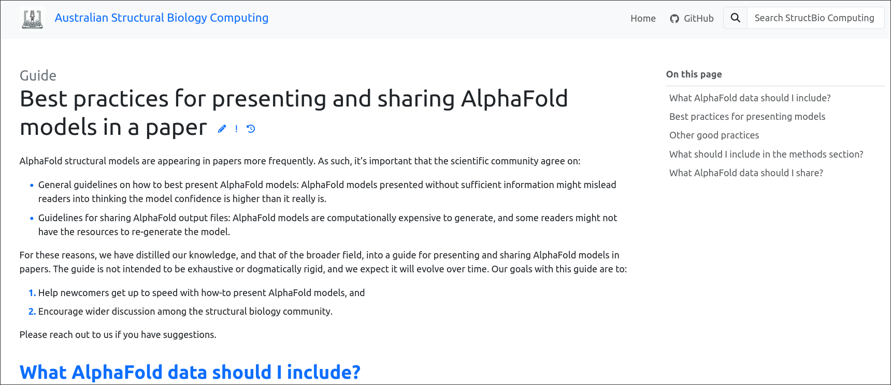
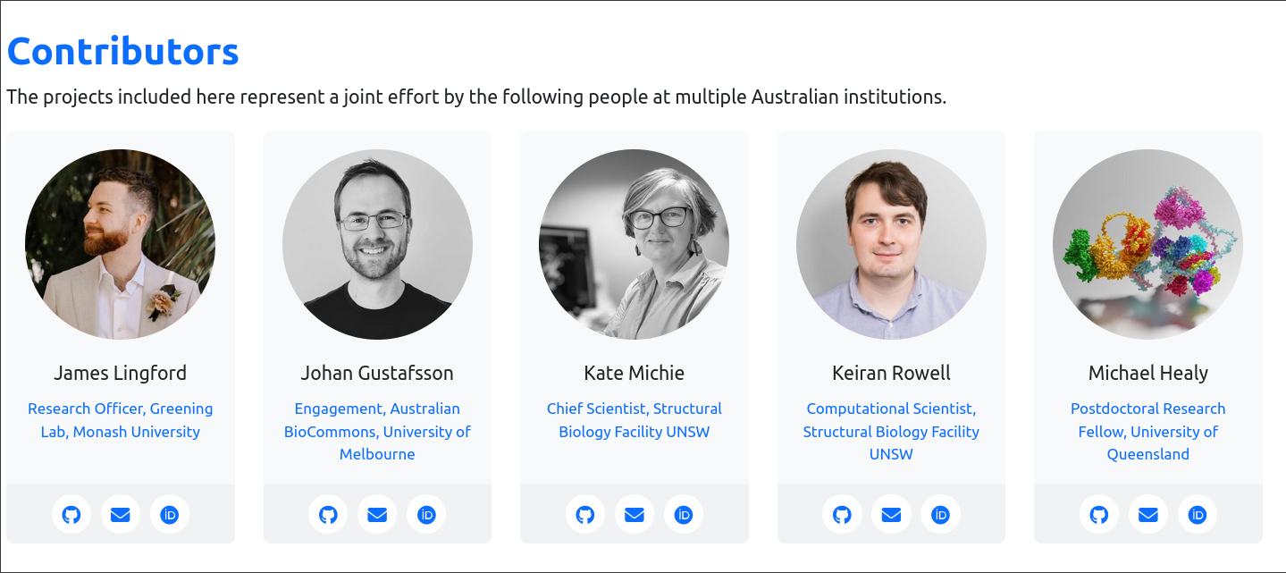
Building the Australian
Computational Structural Biology Community
australian-structural-biology-computing.github.io/website/

Slide 5
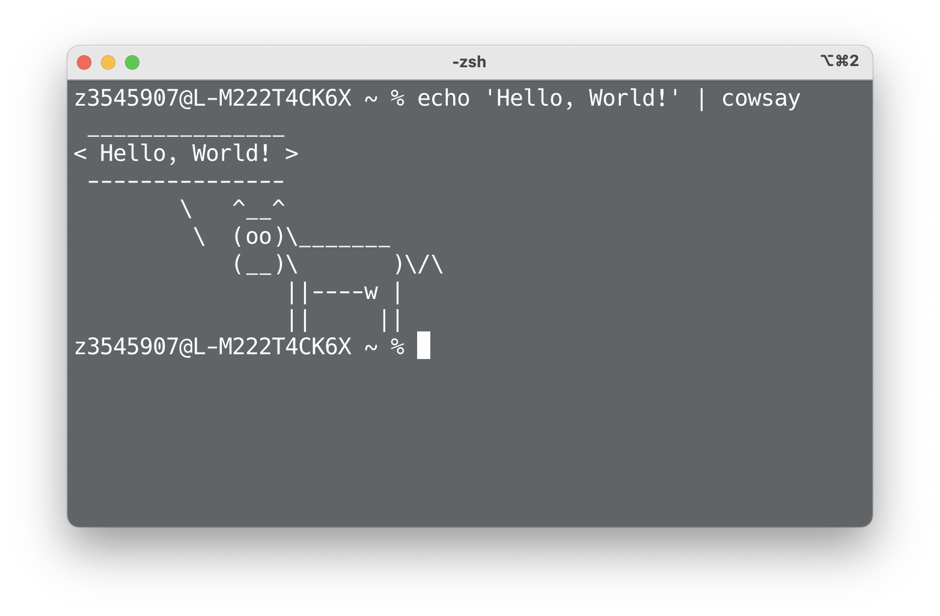
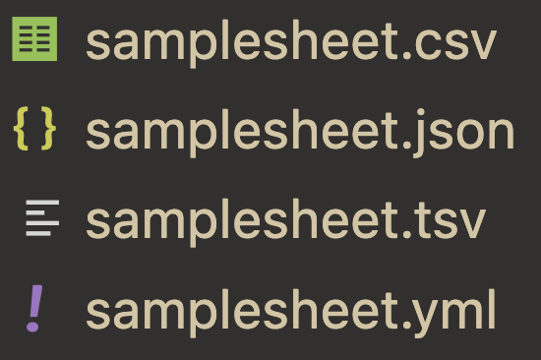

Problems Facing Computational Protein Folding Adoption
Command line
File Formats
Resource Allocation
Command line can be very finicky. Researchers shouldn’t have to touch it.
Different folding classes want different file formats and different parameters.
What resources should you allocate to your job? How much do you need?

Slide 6
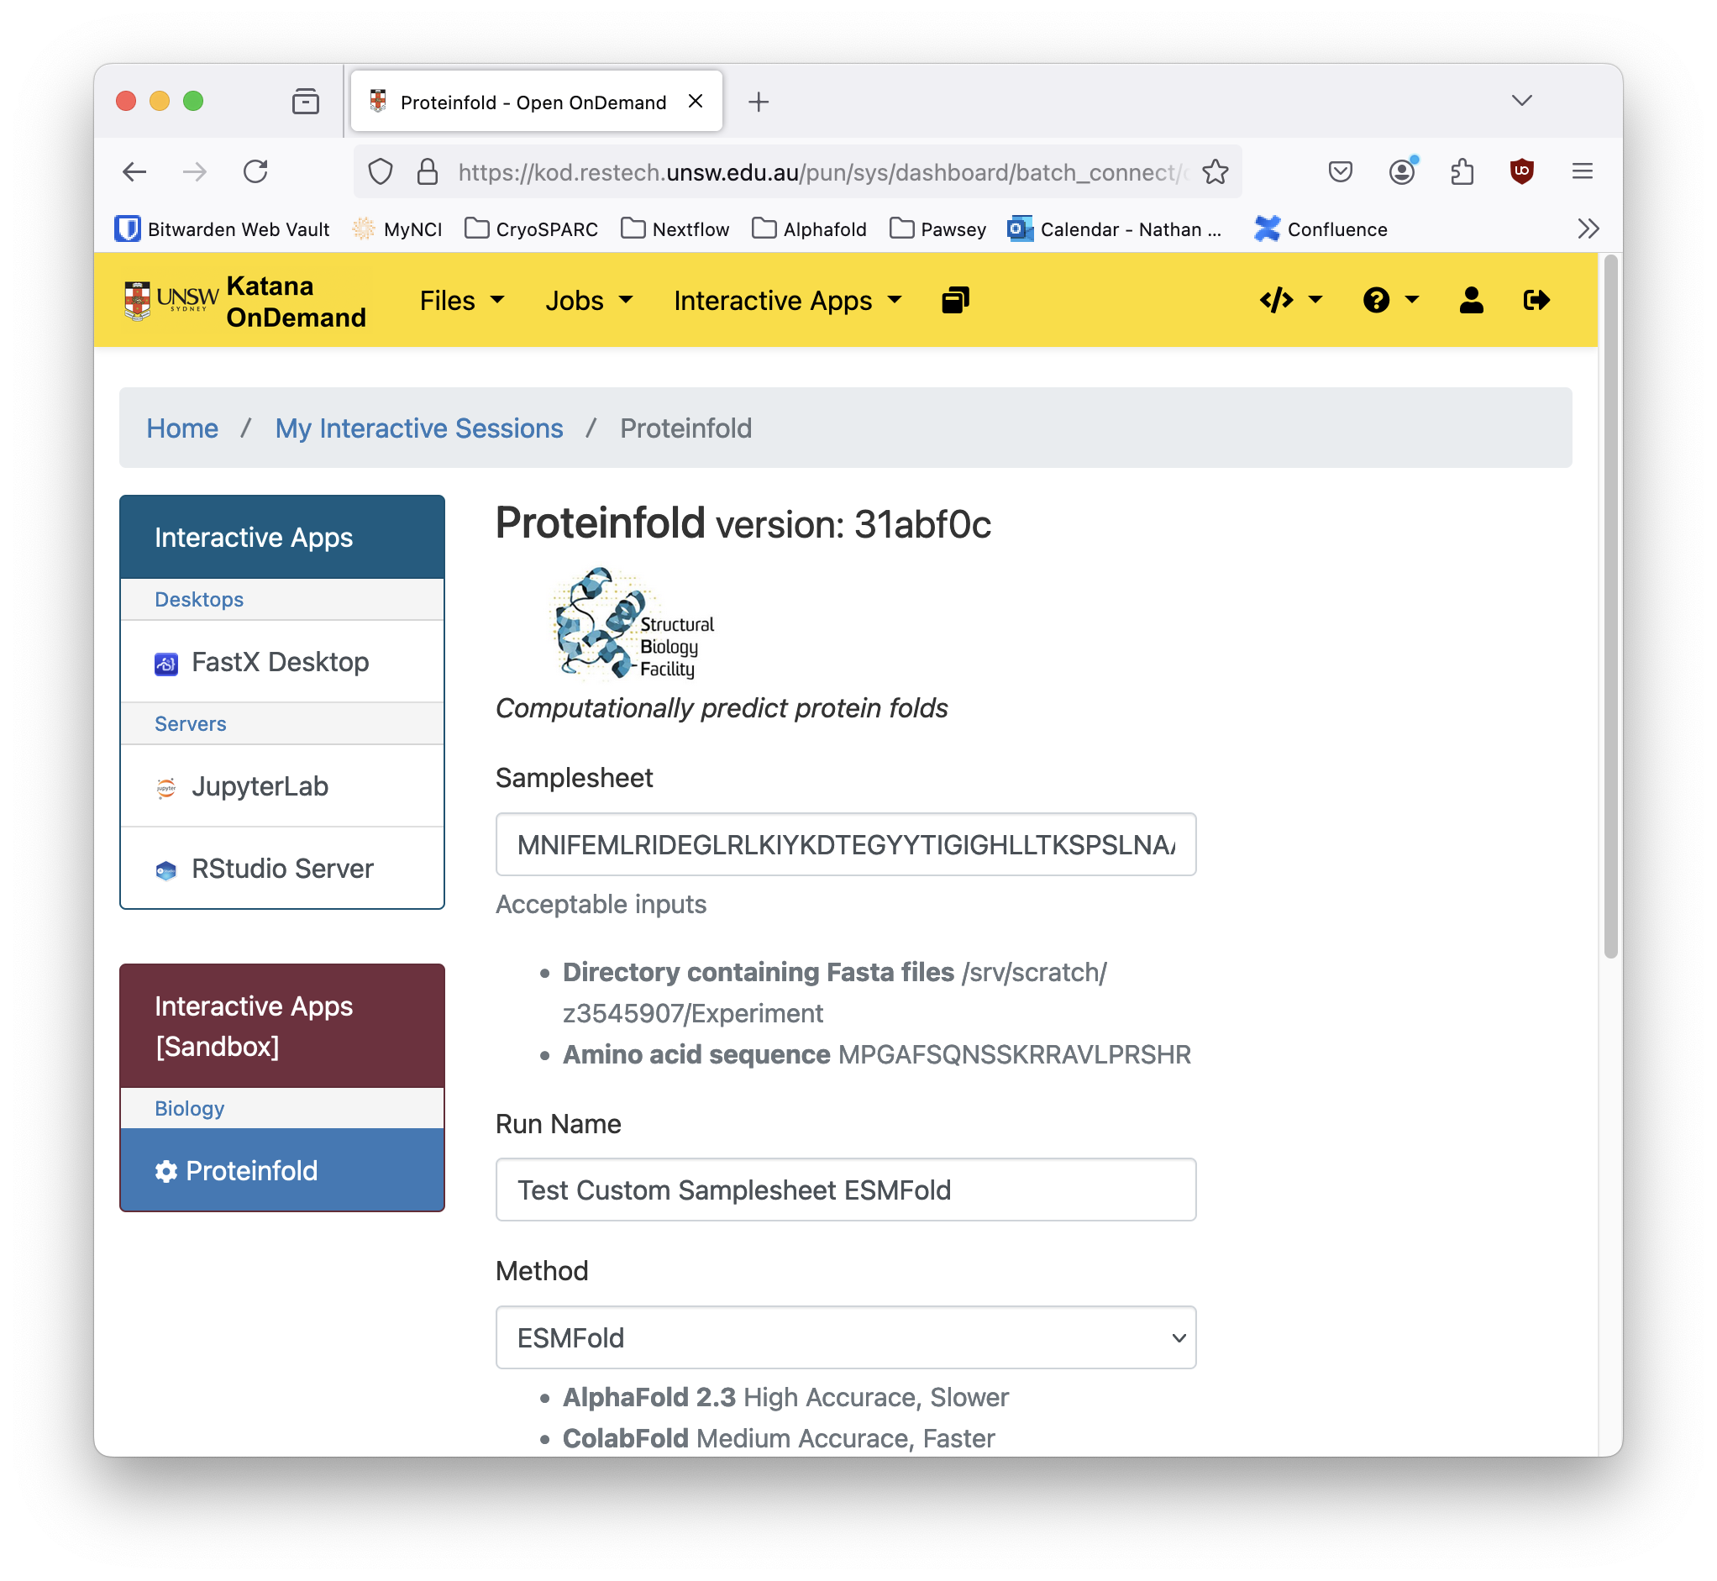
Solutions: Command Line
OnDemand
Provides a nice frontend for users
Easily manage previous and currently running jobs
Integrates with local cluster schedulers
Easily add, remove and modify fields

Slide 7
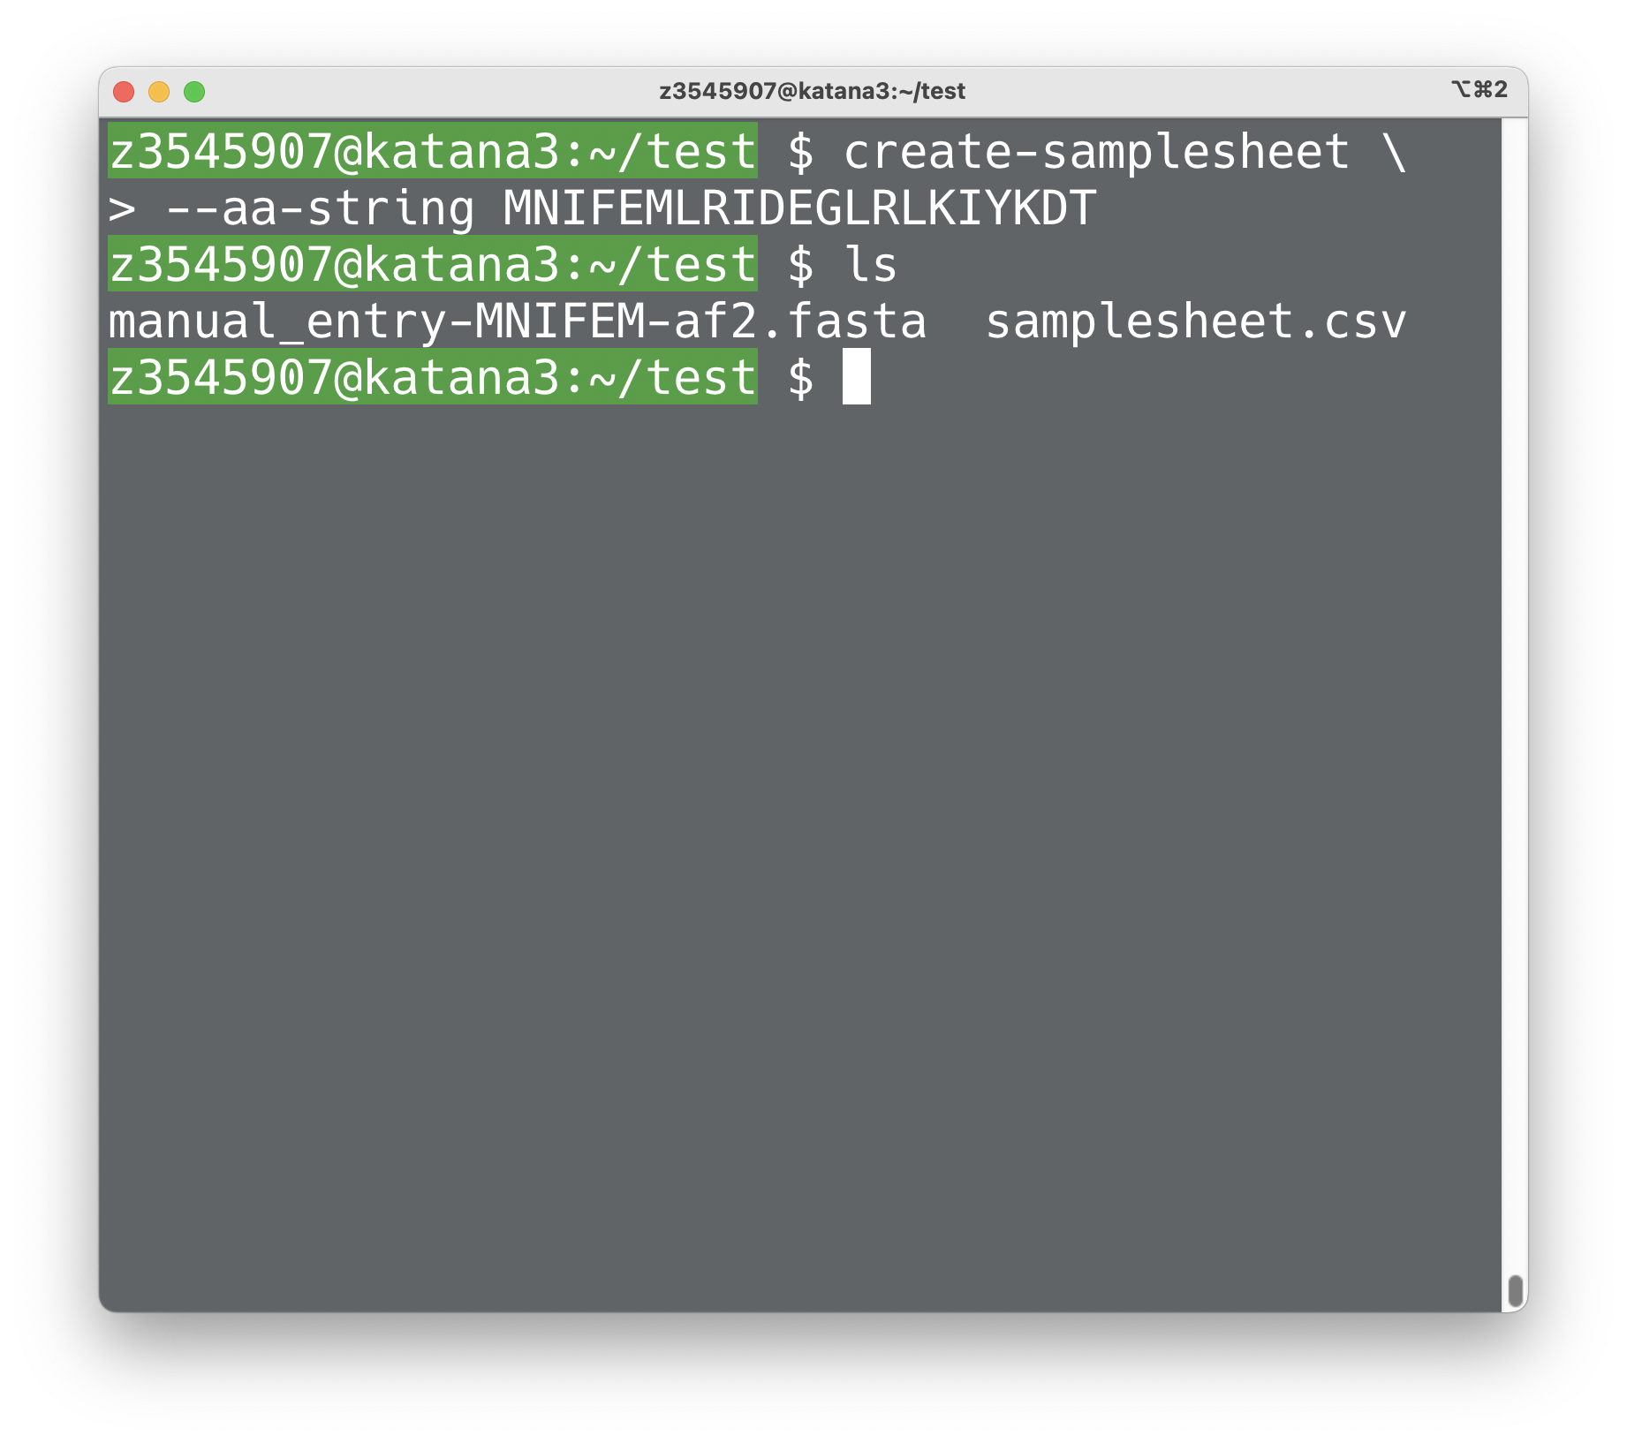
Solutions: Samplesheet
samplesheet-utils
Easily create samplesheets from directories containing FASTA files
Create a samplesheet from manual input sequence
Translate samplesheets to different formats
Easily integratable into Nextflow pipelines
https://github.com/Australian-Structural-Biology-Computing/create-samplesheet

Slide 8
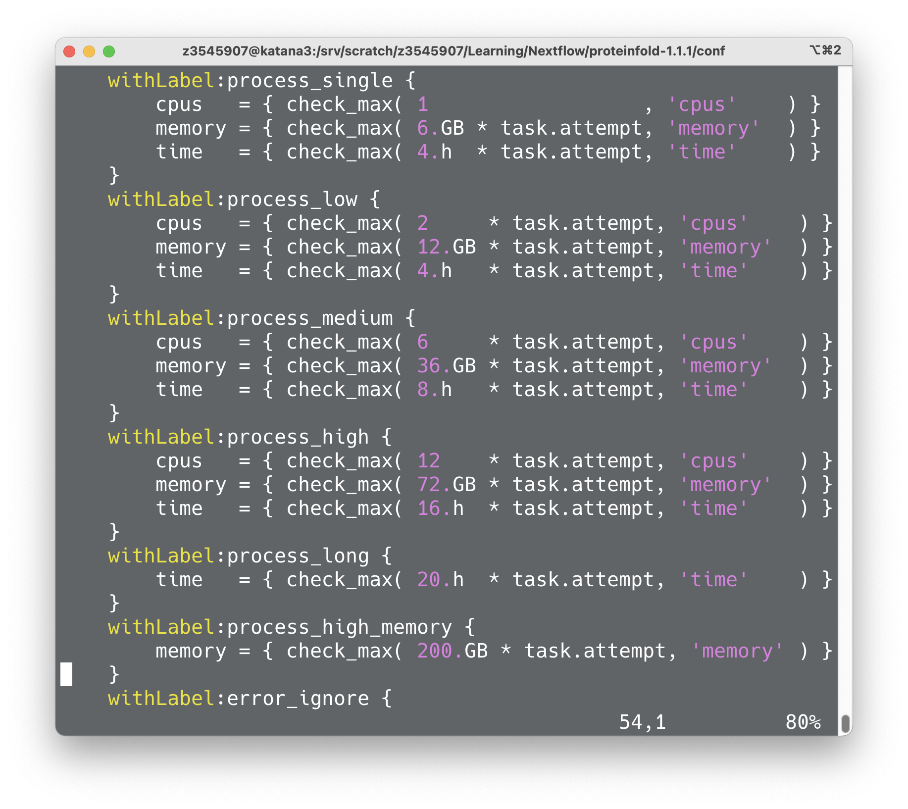
Solutions: Resource Allocation
Nextflow
Can dynamically choose how many resources to allocate depending on the task
Automatically parallelise jobs
Automatically retry with more resources if jobs run out of memory, etc.

Slide 9
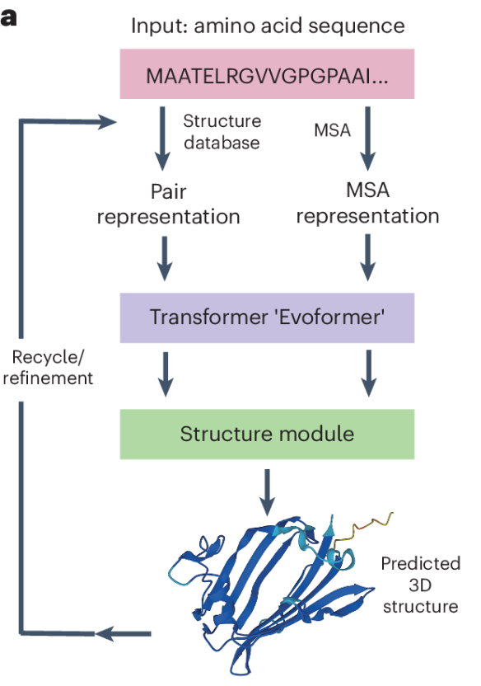
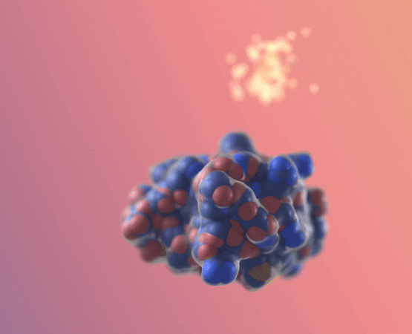

Advancements in Structural Software: Predicting, Generating, and Aligning Biomolecular Structures
Structure Prediction
Diffusion Models
Structure Alignment

Slide 10
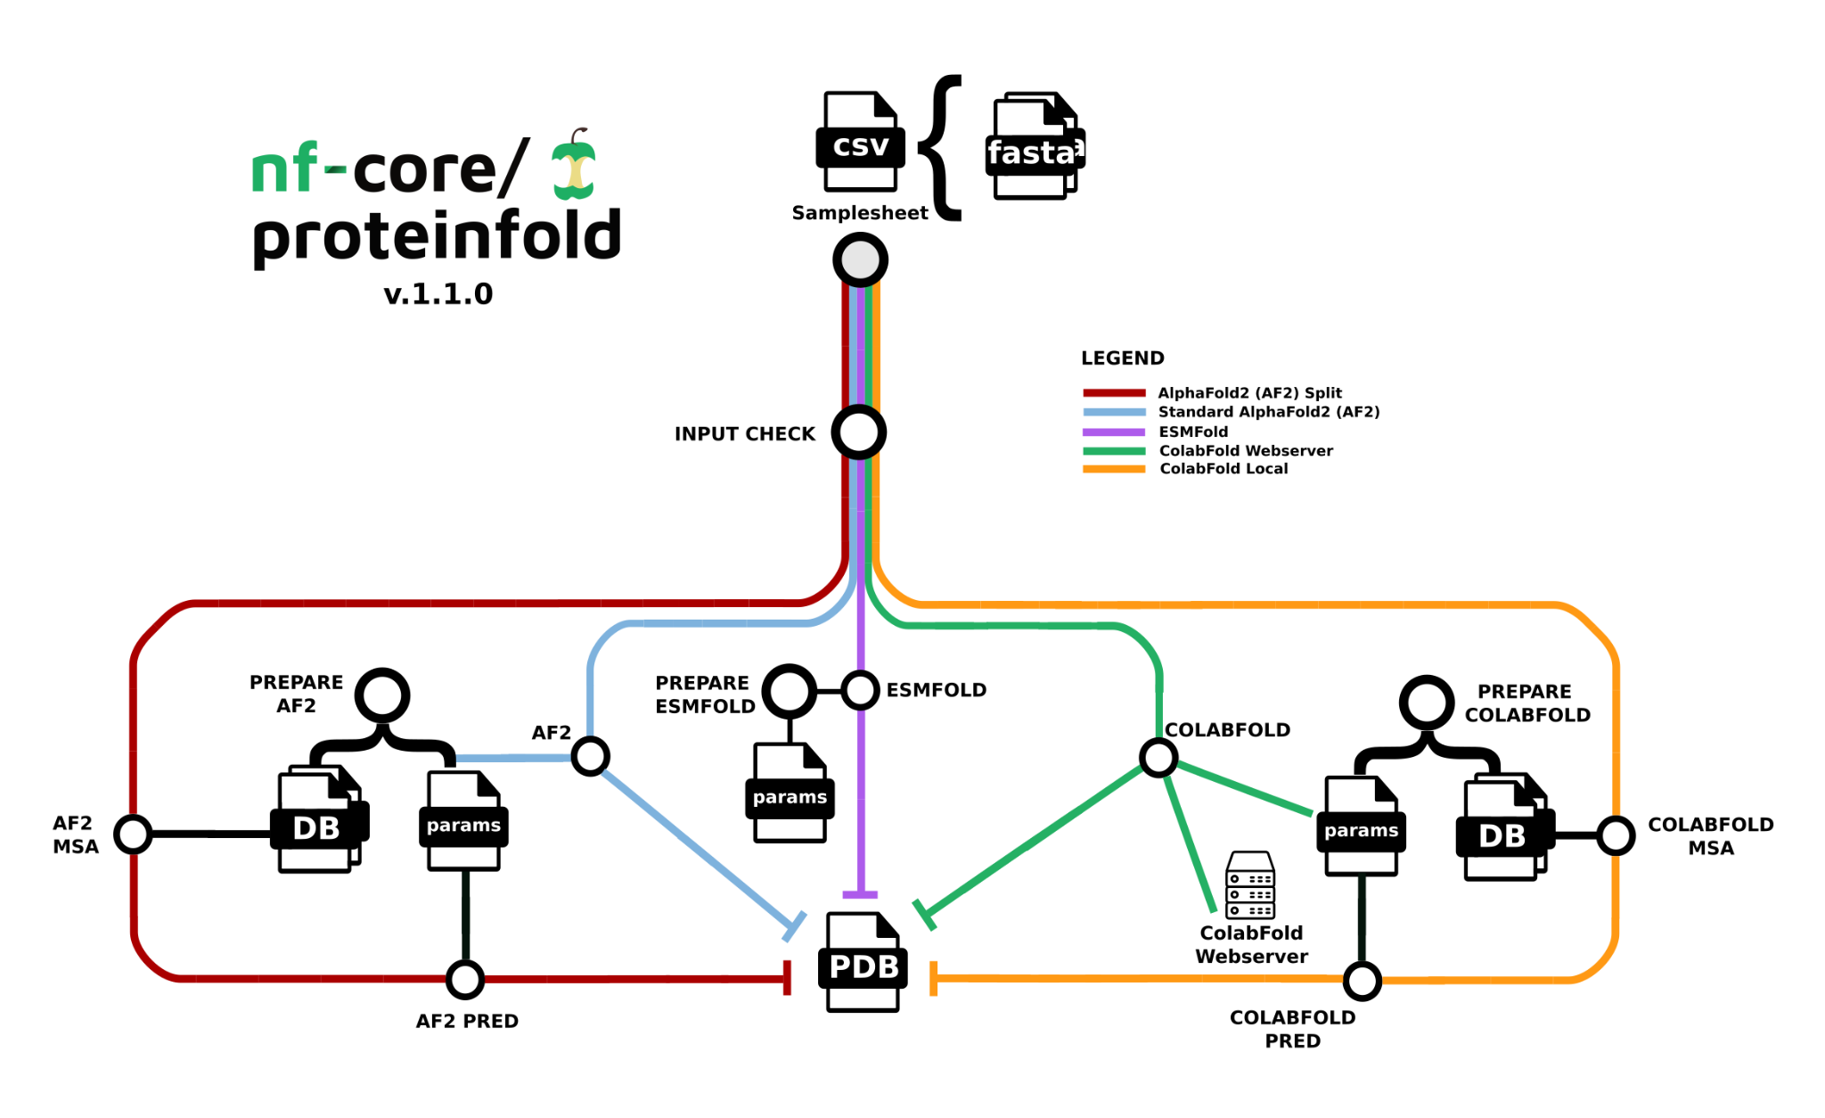
Future Directions in Binder Design and Structural Biology
In silico screen
Sequence design
ProteinMPNN
++
RoseTTAFold-All-Atom
HelixFold3
Diffusion Models
RFDiffusion
BindCraft

